Slide 1
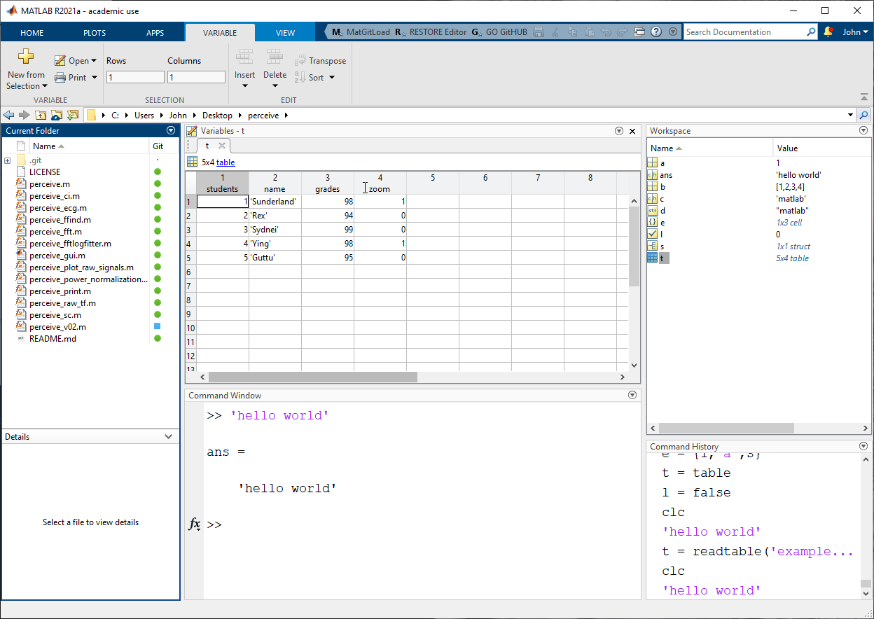

Mature IDE

Slide 2
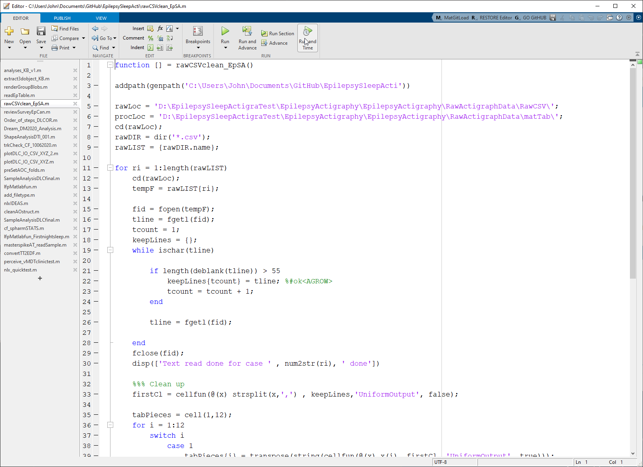
.m files
Scripts
Functions

Slide 3
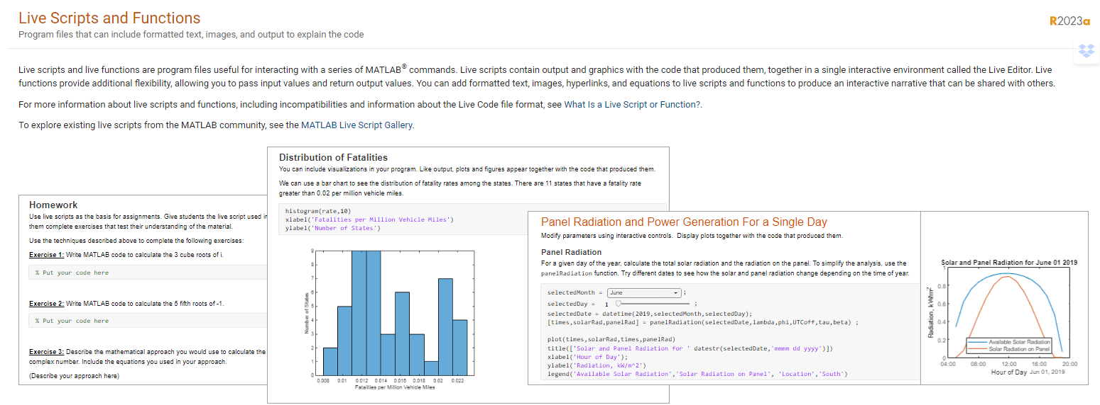

Slide 4





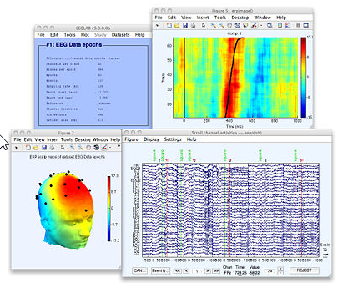
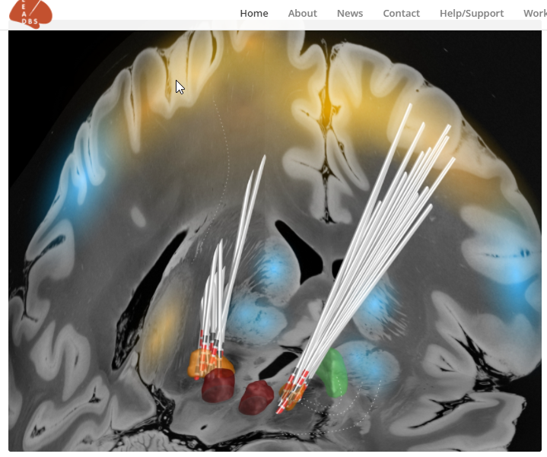
Company: The MathWorks
Products: MATLAB and Simulink
Est. 1984
Commercial programming language and environment
- Used in industry and the basic sciences
Similar to Python:
- It is a ‘scripted’ / ‘interpreted’ language
MathWorks provides extended functionality through Toolboxes:
Image Processing Toolbox
Signal Processing Toolbox
User generated function libraries
MathWorks File Exchange
Github
NIH supported field standard tools for human neuroscience (+20 years)

Slide 5
Advantages:
Stable language and toolboxes for Mathworks products
Robust/mature IDE
Syntax is moderately easy to learn [i.e., Julia] – arguably the second most readable data science
Like Python/R/Julia – interpreted, can be queried line-by-line
Base data type is matrix – makes vectorized programming very intuitive – easy to rapid prototype complex algorithms in base MATLAB
With campus license can request engineering assistance with code problem
Disadvantages:
Slow to adapt – Python/R/Julia – bleeding edge developments in Stats/ML
Proprietary – less optimal for sharing/open sourcing code
Matlab does have Live Scripts (similar to a notebook), but is FAR behind with browser based, collaborative interaction [basically non-existent] – although work in progress.
Does not have the vibrant active package development
Data visualization
Data exploration
ML
TERRIBLE for common statistics – compared to R/Python

Slide 6
Python
Dictionary
List
Float
Int
String
Tuple
DataFrame
~
Matlab
Struct / Dictionary (*) as of 2023a
Cell array
Double
Int
String
~
Table
Character

